Slide 1
API Design Principles
Ishaan Malik

Slide 2
API Design Principles
API Design Principles are a set of rules, architectural constraints, and best practices followed when building an Application Programming Interface (API).
Their primary goal is to ensure that the API is easy to use, developer-friendly, secure, scalable, and maintainable over time.

Slide 3
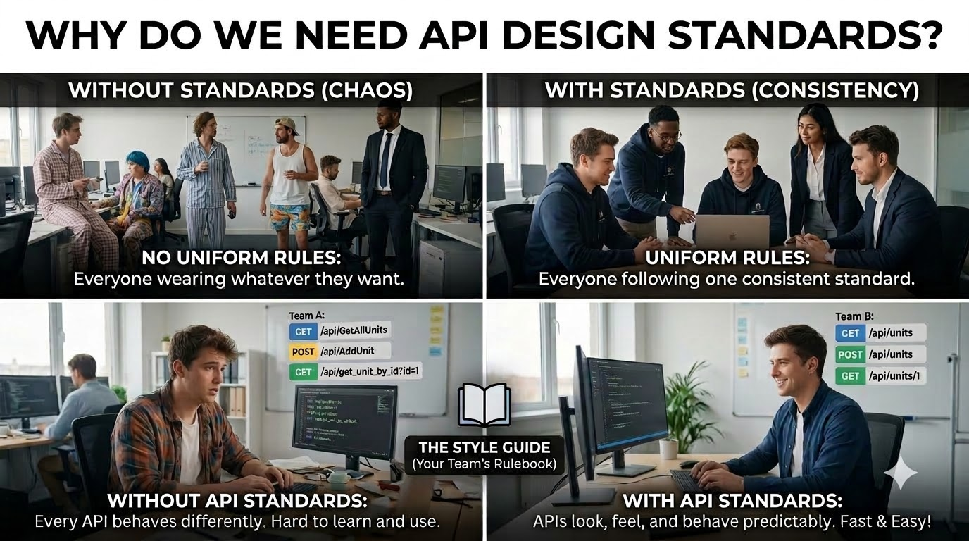

Slide 4
Key Pillars of API Design
Predictability: Endpoints should follow a consistent naming structure so developers can guess how to interact with new resources.
Standardization: Utilizing existing protocols effectively (like HTTP methods, standard status codes, and JSON payloads).
Decoupling: Ensuring changes to backend database schemas do not break the client application's interface.
Robust Tooling: Documenting with frameworks like OpenAPI / Swagger so endpoints are easily testable.

Slide 5
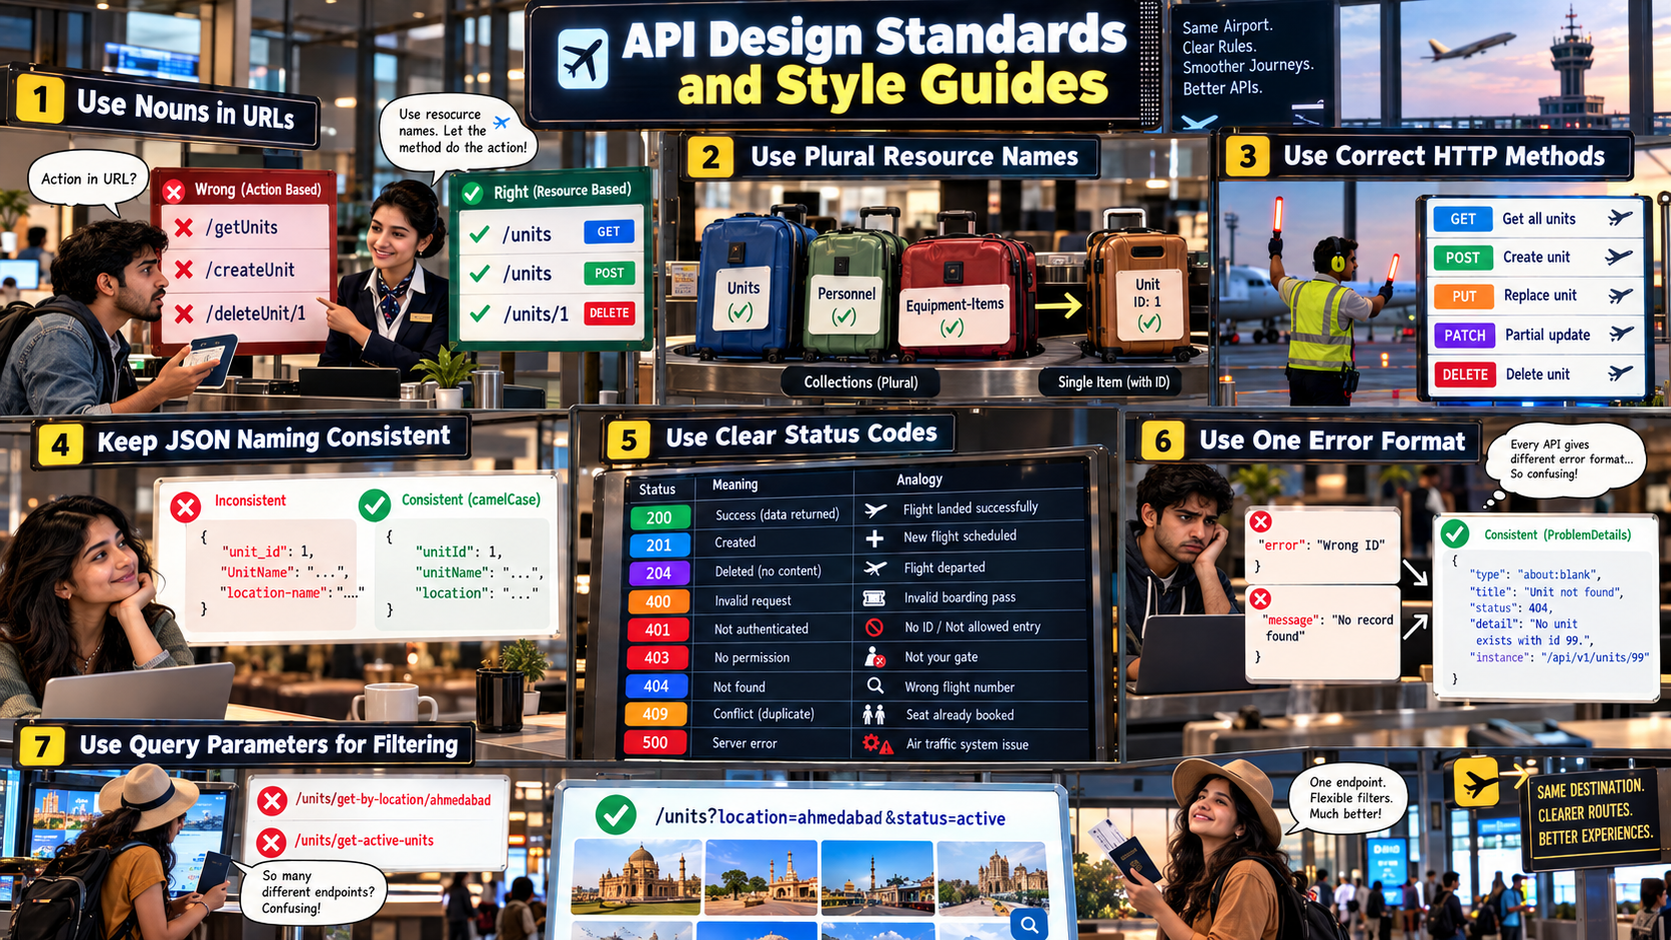

Slide 6
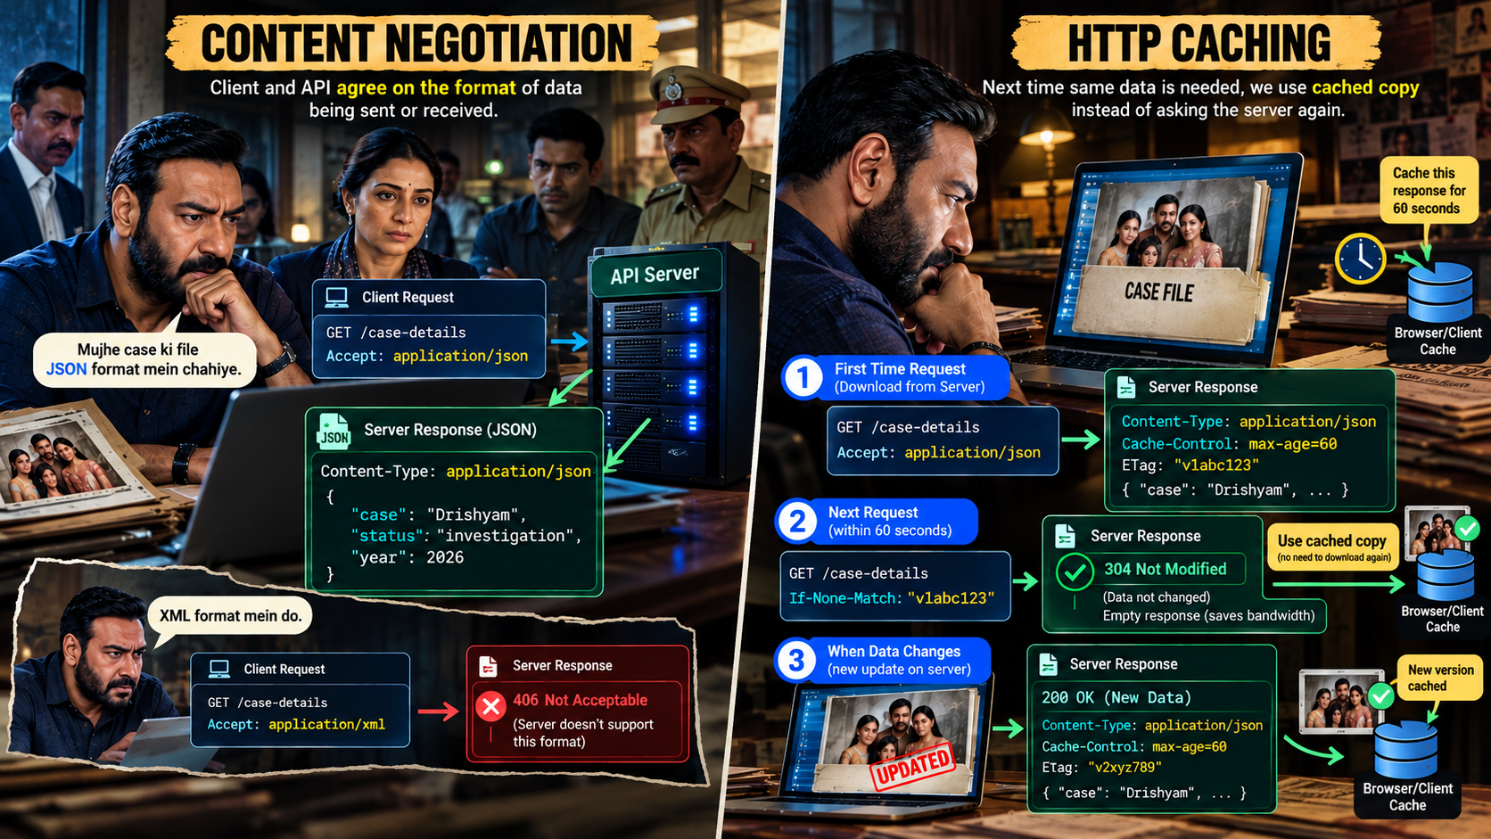

Slide 7
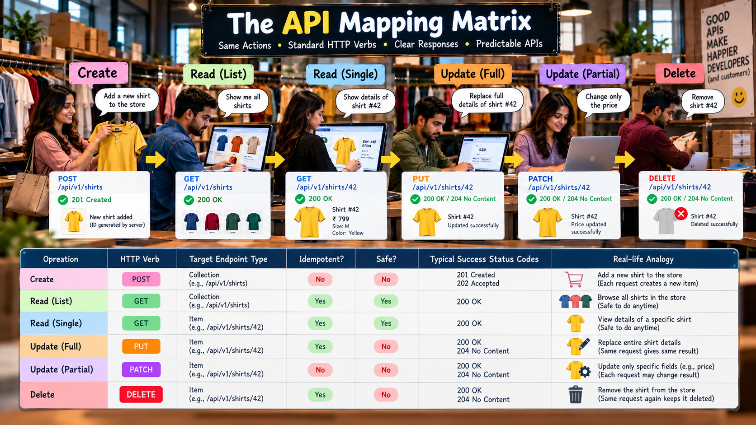

Slide 8
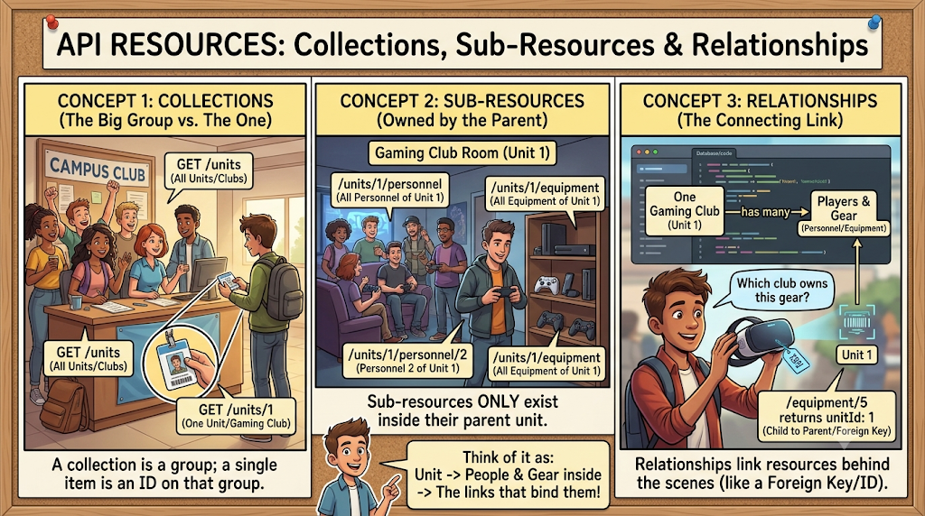

Slide 9


Slide 10
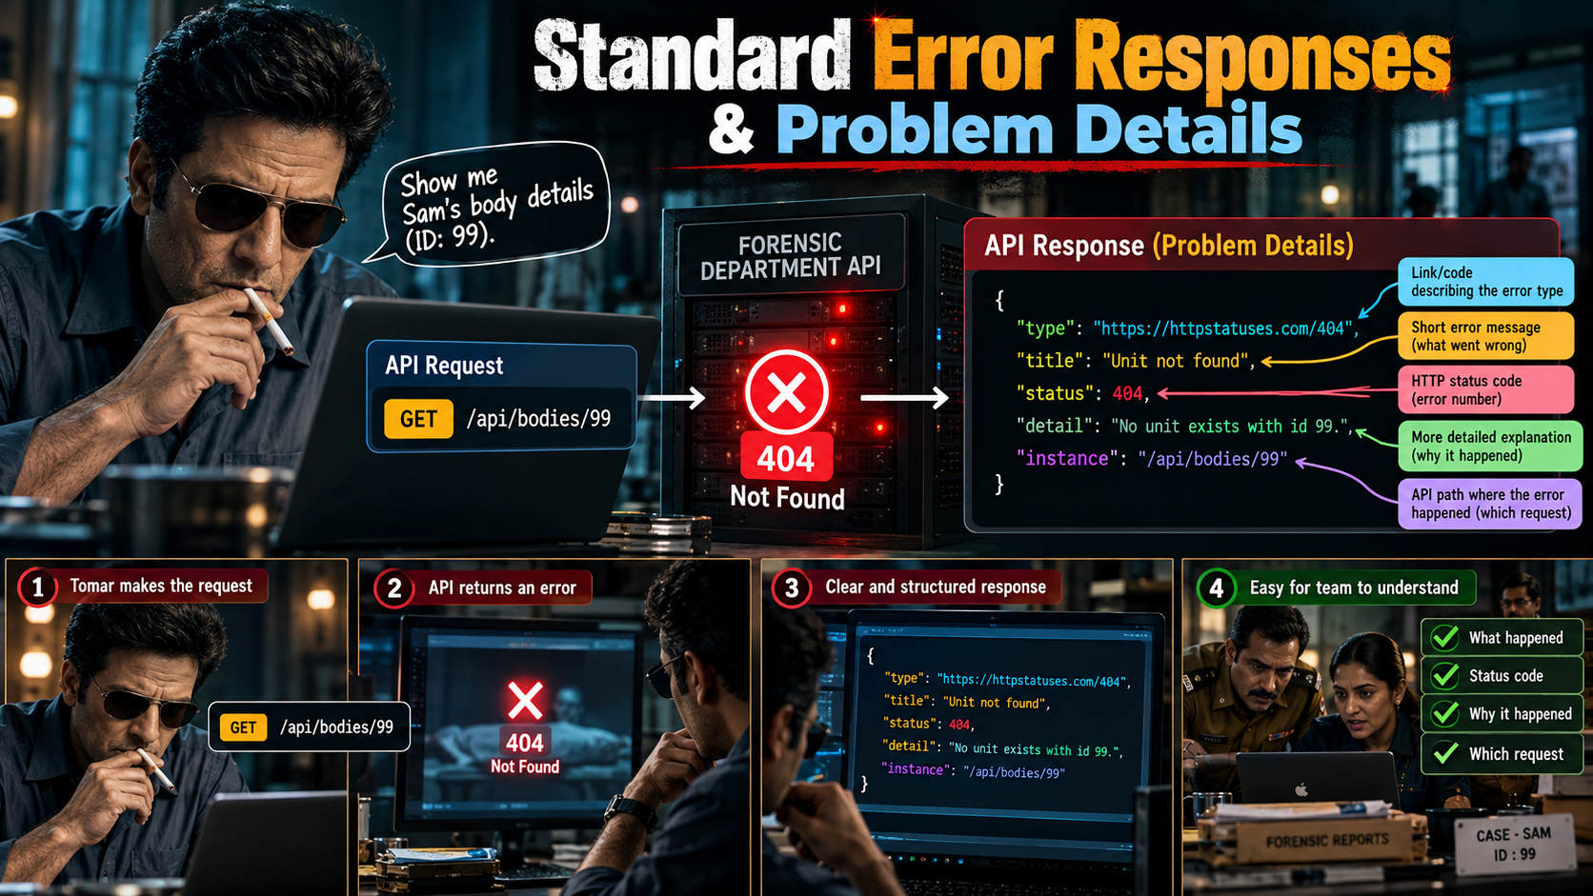

Slide 11


Slide 12
Quick Quiz
Which of the following URI paths correctly follows standard RESTful design principles for retrieving a specific review (ID: 5) belonging to a specific product (ID: 12)?
reviews/5?product=12
/getProductReview/12/5
/products/12/reviews/5
/getReview?productId=12&reviewId=5
Answer: C

Slide 13
Quick Quiz
What's the main benefit of a standard error shape like Problem Details?
It makes errors shorter
The calling app writes one error-handling routine that works for every endpoint
It removes the need for status codes
It's required by JSON
Answer: B

Slide 14
Quick Quiz
What problem does a correlation ID solve that caching and filtration don’t?
Speed
Formatting JSON consistently
Reducing payload size
Tracing one request's path across multiple systems
Answer: D

Slide 15
Quick Quiz
Which of the following statements regarding HTTP method safety and idempotency in REST architecture is correct?
GET is both safe and idempotent.
POST is idempotent, whereas PUT is not idempotent.
DELETE is safe because it does not modify the client-side state.
PATCH is always guaranteed to be idempotent regardless of the implementation.
Answer: A

Slide 16
Q&A
The End

